Slide 1
DIGITAL DESIGN AND COMPUTER ARCHITECTURE
COURSE OUTCOME 1 PROJECT

Slide 2
PROJECT TITLE:
DESIGNING AND SIMULATION OF HALF-ADDER AND FULL-ADDER CIRCUITS

Slide 3
PRESENTED BY:
1. NIKHIL SRIVATSA-2620090029
2. SRI VISHWA CHAITANYA-2620090036
3. DARAPU VINOD KUMAR-2620090068
4. JASWANTH POORNA SAI-2620090097

Slide 4
PROJECT OBJECTIVES
Understand Binary Addition Basics
  Grasp the fundamental principles of binary addition and how logic gates implement arithmetic operations.
Design a Half Adder Circuit
  Construct a half adder using XOR and AND gates to perform single-bit addition without a carry input.
  Verify its correctness using a truth table.
Design a Full Adder Circuit
  Extend the half- adder design to include a carry-in input, combining two half -adders and an OR gate.
  Demonstrate accurate addition of three binary inputs.

Slide 5
BASIC CONCEPT
HALF ADDER CIRCUIT
FULL ADDER CIRCUIT
Purpose: Adds two single-bit binary numbers (A and B).
Inputs: A, B
Outputs:
  Sum (S) → Generated using an XOR gate (A ⊕ B)
  Carry (C) → Generated using AND gate (A · B)
Concept:
  The XOR gate gives the sum because it outputs 1 only when the inputs differ.
  The AND gate gives the carry because a carry occurs only when both inputs are 1.
Purpose: Adds three single-bit binary numbers (A, B, and Carry-in).
Inputs: A, B, Cin
Outputs:
  Sum (S) → (A ⊕ B) ⊕ Cin
  Carry (Cout) → (A · B) + (Cin · (A ⊕ B))
Concept:
  Built using two Half Adders and an OR gate.
  The first Half Adder adds A and B.
  Second Half Adder adds the Sum from the first stage with Cin.
  The OR gate combines the carry outputs to produce Cout.

Slide 6
INPUT COMPONENTS AND OUTPUT DESCRIPTION
HALF ADDER
Inputs:
A → First single-bit binary input
B → Second single-bit binary input
Outputs:
Sum (S) → Produced by XOR gate (A ⊕ B)
  Output is 1 when inputs differ (A=0, B=1 or A=1, B=0).
Carry (C) → Produced by AND gate (A · B)
  Output is 1 only when both inputs are 1.
Description: The Half Adder performs addition of two bits but does not account for a carry-in from a previous stage.
FULL ADDER
Inputs:
A → First single-bit binary input
B → Second single-bit binary input
Cin (Carry-in) → Carry input from a previous addition
Outputs:
Sum (S) → (A ⊕ B) ⊕ Cin
  Output is 1 when an odd number of inputs are 1.
Carry-out (Cout) → (A · B) + (Cin · (A ⊕ B))
  Output is 1 when at least two inputs are 1.
Description: The Full Adder extends the Half Adder by including a carry-in, making it suitable for chaining multiple adders to perform multi-bit binary addition

Slide 7
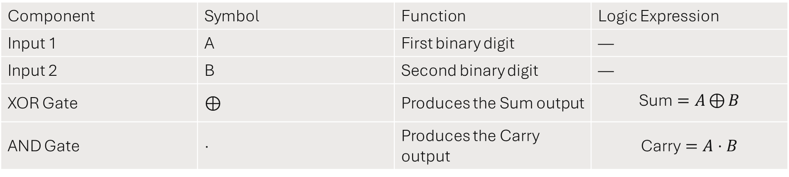
LOGIC DESIGN FOR HALF ADDER CIRCUIT
Component | Symbol | Function | Logic Expression
Input 1 | A | First binary digit | —
Input 2 | B | Second binary digit | —
XOR Gate | ⊕ | Produces the Sum output | $$\text{Sum}=A⊕{B}$$
AND Gate | · | Produces the Carry output | $$\text{Carry}=A⋅B$$

Slide 8
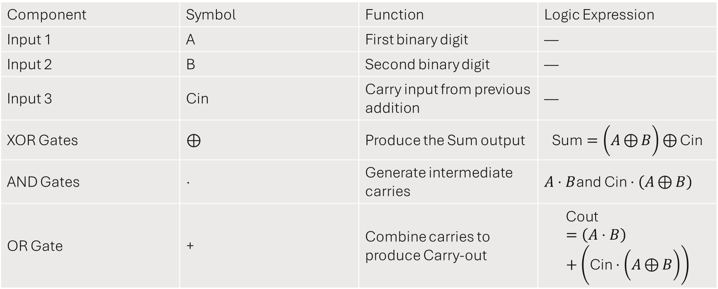
LOGIC DESIGN FOR FULL ADDER CIRCUIT
Component | Symbol | Function | Logic Expression
Input 1 | A | First binary digit | —
Input 2 | B | Second binary digit | —
Input 3 | Cin | Carry input from previous addition | —
XOR Gates | ⊕ | Produce the Sum output | $$\text{Sum}=\left(A⊕{B}\right)⊕{\text{Cin}}$$
AND Gates | · | Generate intermediate carries | $A⋅B$and $\text{Cin}⋅\left(A⊕{B}\right)$
OR Gate | + | Combine carries to produce Carry-out | $$\text{Cout}=\left(A⋅B\right)+\left(\text{Cin}⋅\left(A⊕{B}\right)\right)$$

Slide 9
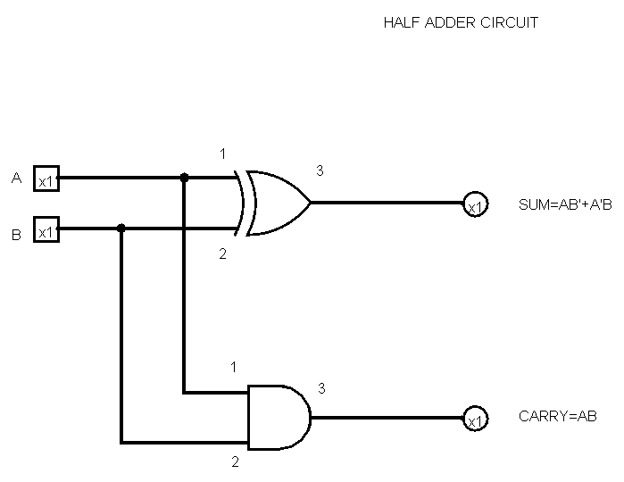
HALF ADDER CIRCUIT LOGIC OUTPUT

Slide 10
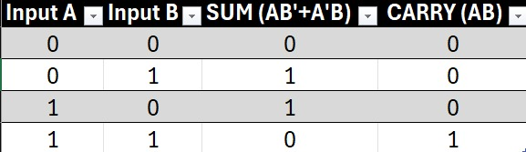
TRUTH TABLE OF HALF ADDER CIRCUIT

Slide 11
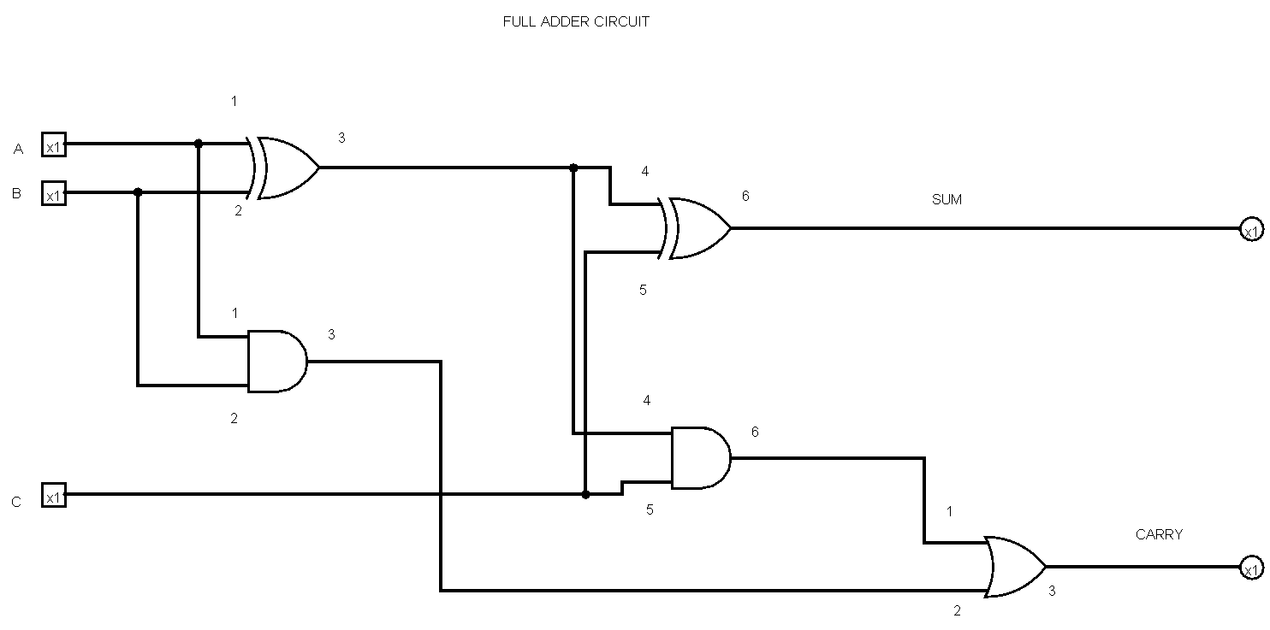
FULL ADDER CIRCUIT LOGIC OUTPUT

Slide 12
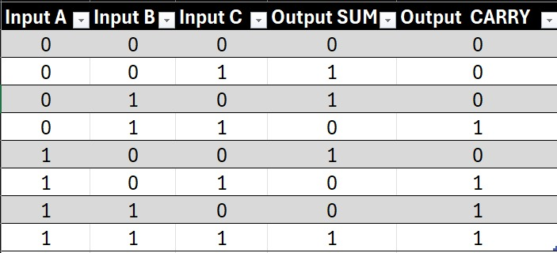
TRUTH TABLE FOR FULL ADDER CIRCUIT

Slide 13
EXPECTED RESULT FOR HALF ADDER
When both inputs are 0, the output is Sum = 0, Carry = 0.
When one input is 1 and the other is 0, the output is Sum = 1, Carry = 0.
When both inputs are 1, the output is Sum = 0, Carry = 1.

Slide 14
EXPECTED RESULT FOR FULL ADDER
Sum is 1 when an odd number of inputs are 1.
This ensures correct addition of three binary inputs (A, B, and Cin).
Carry-out (Cout) is 1 when at least two inputs are 1.

Slide 15
THANK YOU

